Slide 1



AIMED
Where machine learning met medicine
-Ritesh Kashyap, E22cseu0121

Slide 2


Introduction
Disease prediction using machine learning is a rapidly evolving field at the intersection of data science and healthcare.
So, Why is it so Important? Because the importance of accurately predicting diseases cannot be understated, as it allows for early detection, timely intervention, and improved patient outcomes.
The Doctors may not be able to correctly identify the Disease by just the few symptoms named by the patient and may make errors.
So, this model acts as a helping hand for the Doctor, making predictions for the disease with a certain percentage of confidence to help out.

Slide 3
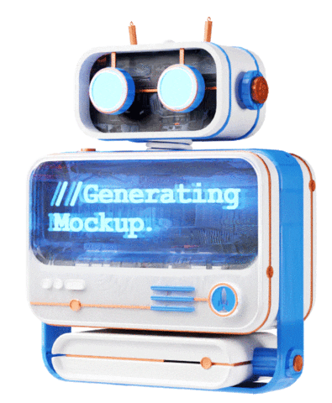

What are we using in this?

Slide 4
What are we using in this?
Machine Learning Models:
Logistic Regression
Decision Trees
Random Forest
We are using multiple models so that we can have data from various models rather than depending on a single model.

Slide 5
What are we using in this?
Machine Learning Models:
Logistic Regression
Decision Trees
Random Forest
We are using multiple models so that we can have data from various models rather than depending on a single model.

Slide 6
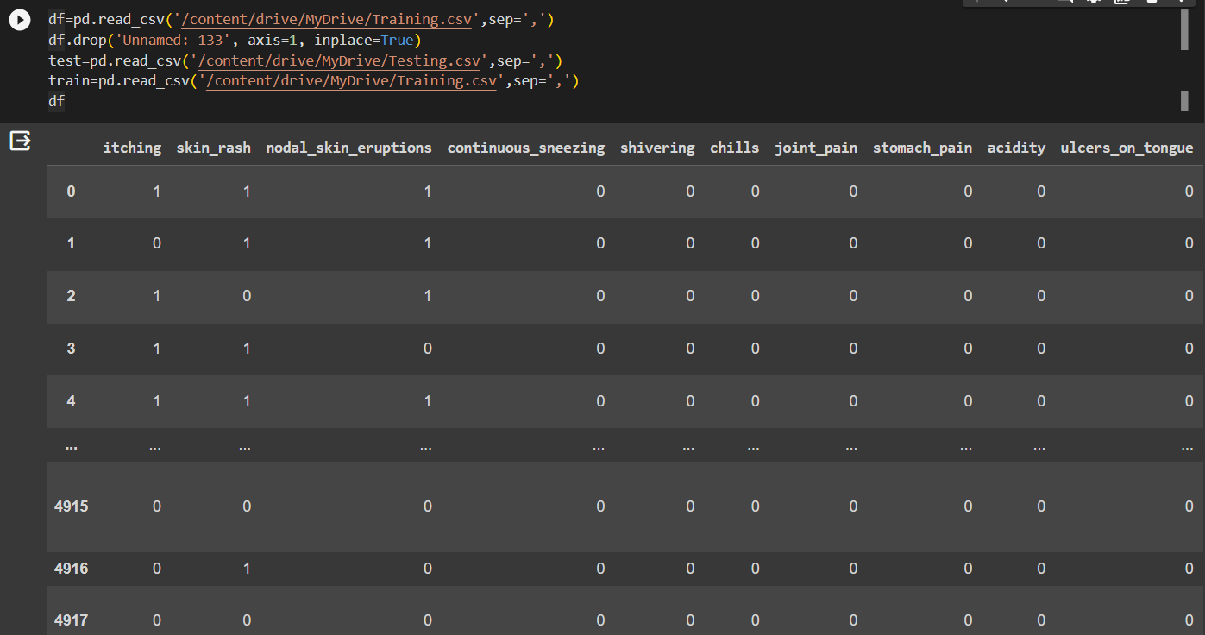
ABOUT THE DATA USED FOR TRAINING
Data collection and pre-processing
The Kaggle disease prediction dataset is used for training this model.
This dataset has 132 parameters on which 42 different types of diseases can be predicted.
So basically,
The Complete Dataset consists of 2 CSV files . One of them is training and other is for testing the model.
Each CSV file has 133 columns. 132 of these columns are symptoms that a person experiences and last column is the prognosis.
These symptoms are mapped to 42 diseases you can classify these set of symptoms to.

Slide 7
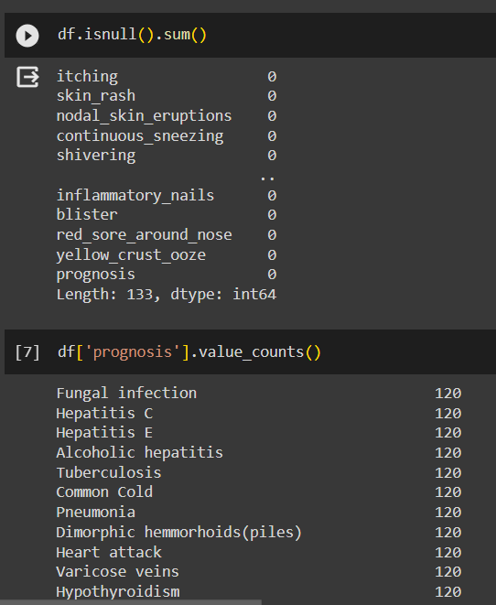

ABOUT THE DATA USED FOR TRAINING
Data collection and pre-processing
Since all the data in the dataset is clean, we don’t have to process the data and it comes out to be like this:
The Kaggle disease prediction dataset is used for training this model.
This dataset has 132 parameters on which 42 different types of diseases can be predicted.
So basically,
The Complete Dataset consists of 2 CSV files . One of them is training and other is for testing the model.
Each CSV file has 133 columns. 132 of these columns are symptoms that a person experiences and last column is the prognosis.
These symptoms are mapped to 42 diseases you can classify these set of symptoms to.

Slide 8
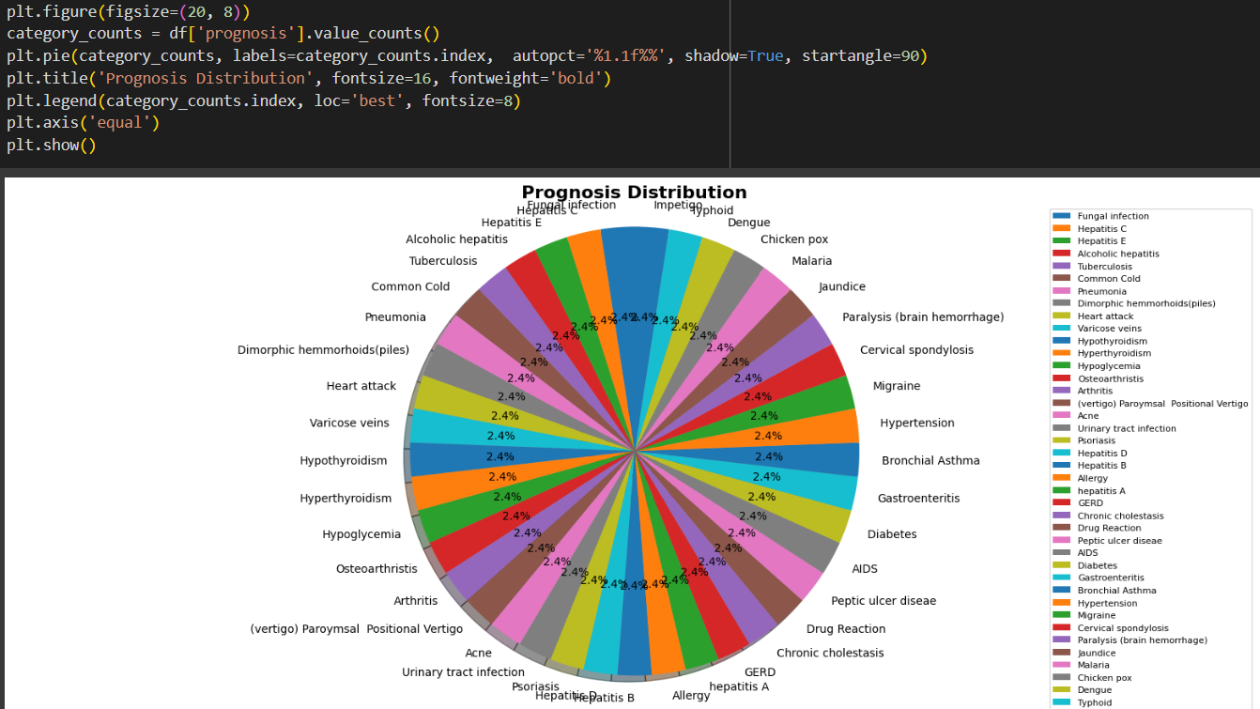
Data Visualization:
Data collection and pre-processing
Since all the data in the dataset is clean, we don’t have to process the data and it comes out to be like this:
This one shows the Prognosis Distribution via a pie chart

Slide 9
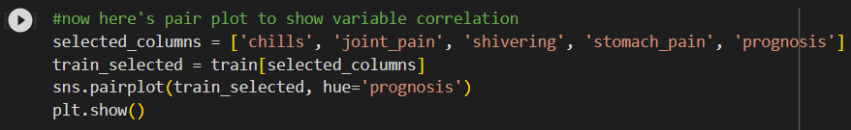
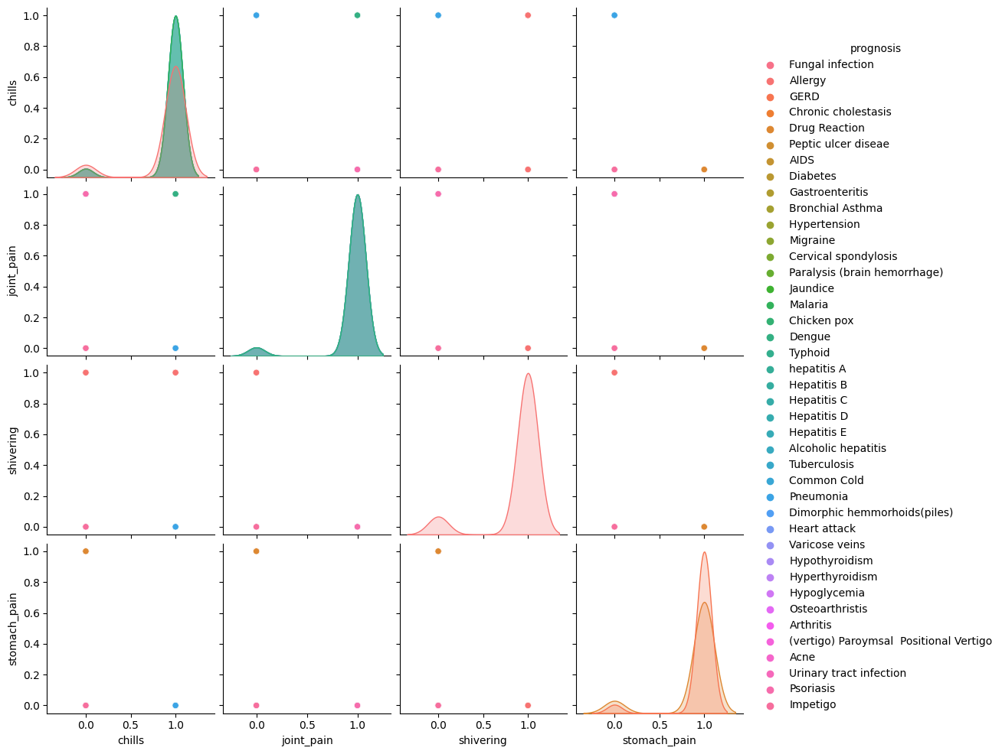
Since all the data in the dataset is clean, we don’t have to process the data and it comes out to be like this:
Here we show the data correlation:
Data collection and pre-processing
Data Visualization:
This one shows the Prognosis Distribution via a pie chart

Slide 10
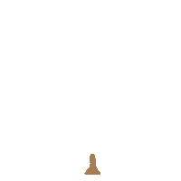
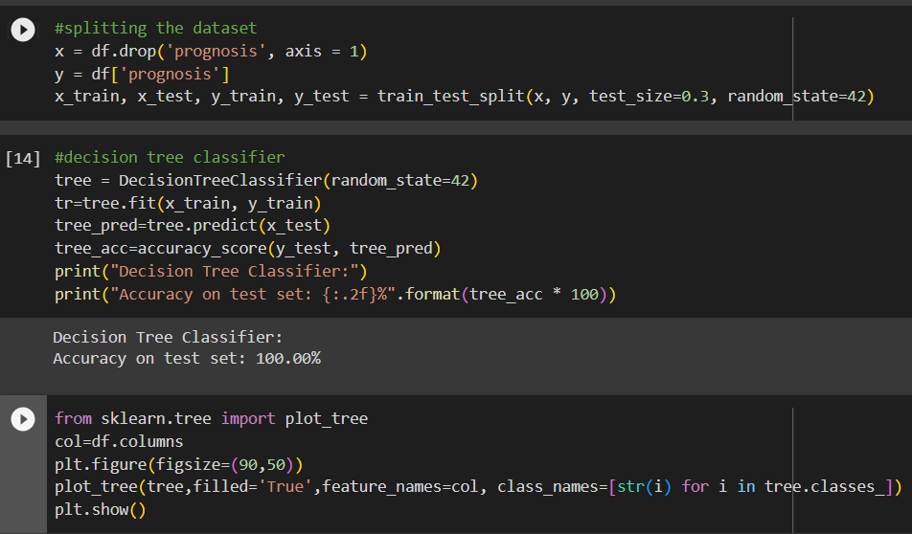
Using the ML Algorithms
Data Visualization:
Here we show the data correlation:
This one shows the Prognosis Distribution via a pie chart

Slide 11
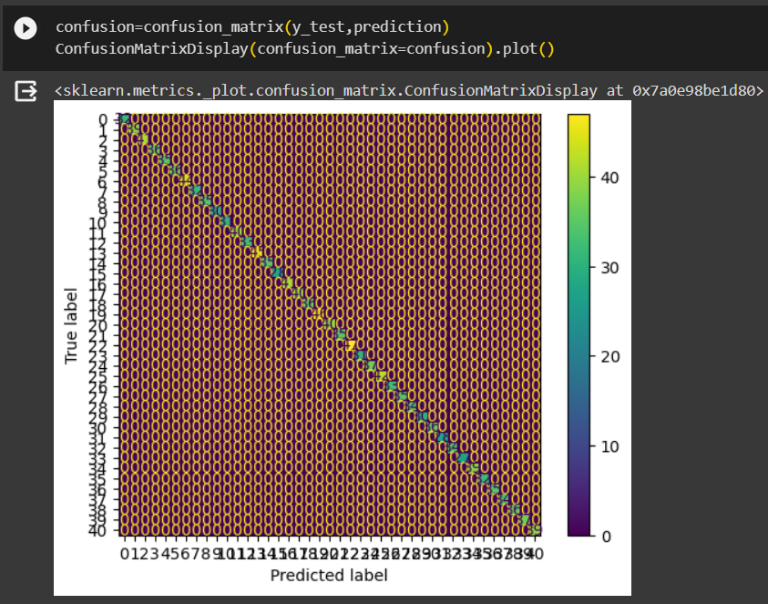
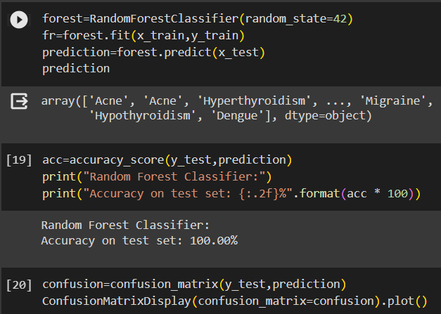
Here we show the data correlation:
Random Forest Classifier:
Using the ML Algorithms
Decision Tree:

Slide 12

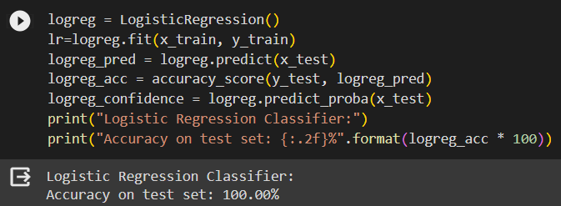
Logistic Regression Model:
Random Forest Classifier:
Decision Tree:
Using the ML Algorithms

Slide 13
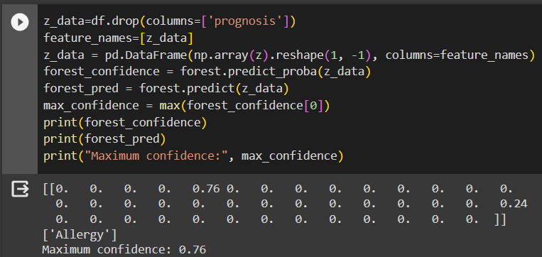
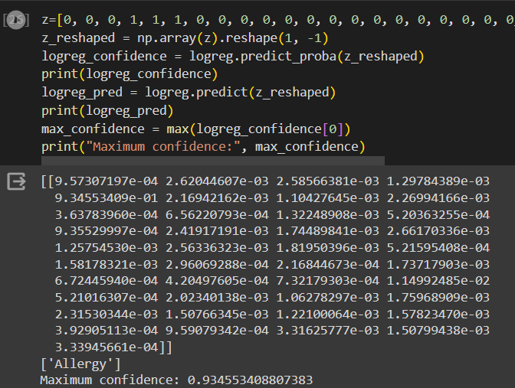
Case Testing
Logistic Regression Model:
The Training and Model fitting is completed here!!
Random Forest Classifier:

Slide 14
Let’s see how can we improve in Future:
Case Testing
The Training and Model fitting is completed here!!
Logistic Regression Model:
We can add a User Interface to make it user friendly and interactive
We can improve the input system
Add speech recognition libraries
Add facial recognition and store it in a different database to maintain records.

Slide 15

Let’s see how can we improve in Future:
CONCLUSION
~ This basic prediction model gets trained by a dataset and provides prediction based on the symptoms.
~ Here, a sample input was provided, and the saved Logistic Regression model was used to make predictions. The predicted class was ‘Allergy' with a maximum confidence score of 0.9345 on Logistic Regression model and 0.76 on a Random forest classifier for the same. Decision tree however predicts the exact class with a maximum confidence score of 1.0.
We can add a User Interface to make it user friendly and interactive
We can improve the input system
Add speech recognition libraries
Add facial recognition and store it in a different database to maintain records.
The Training and Model fitting is completed here!!
Logistic Regression Model:
Case Testing

Slide 16

THANK YOU.
THE END….
Let’s see how can we improve in Future:
CONCLUSION
~ This basic prediction model gets trained by a dataset and provides prediction based on the symptoms.
~ Here, a sample input was provided, and the saved Logistic Regression model was used to make predictions. The predicted class was ‘Allergy' with a maximum confidence score of 0.9345 on Logistic Regression model and 0.76 on a Random forest classifier for the same. Decision tree however predicts the exact class with a maximum confidence score of 1.0.
We can add a User Interface to make it user friendly and interactive
We can improve the input system
Add speech recognition libraries
Add facial recognition and store it in a different database to maintain records.

Slide 17
CONCLUSION
THANK YOU.
THE END….
~ This basic prediction model gets trained by a dataset and provides prediction based on the symptoms.
~ Here, a sample input was provided, and the saved Logistic Regression model was used to make predictions. The predicted class was ‘Allergy' with a maximum confidence score of 0.9345 on Logistic Regression model and 0.76 on a Random forest classifier for the same. Decision tree however predicts the exact class with a maximum confidence score of 1.0.

